Slide 1

Machine Learning
Image Prediction & Tagging
Kelly Lwin​
CS 4200 Artificial Intelligence​
CPP Spring 2025 Final Project​

Slide 2
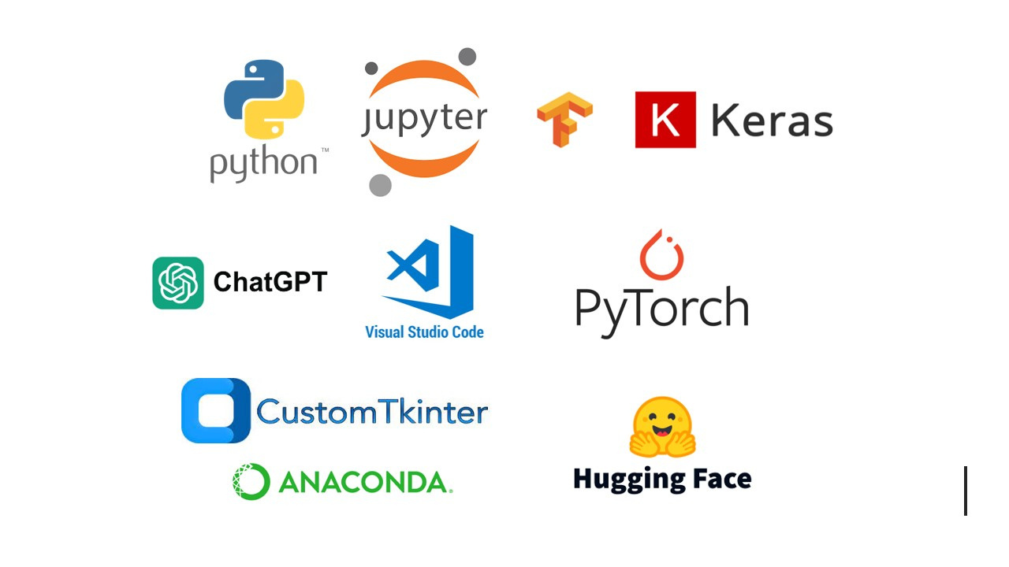
Tools Used

Slide 3


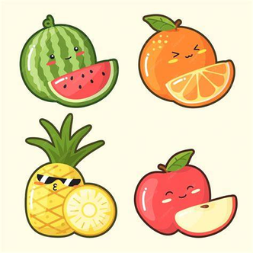
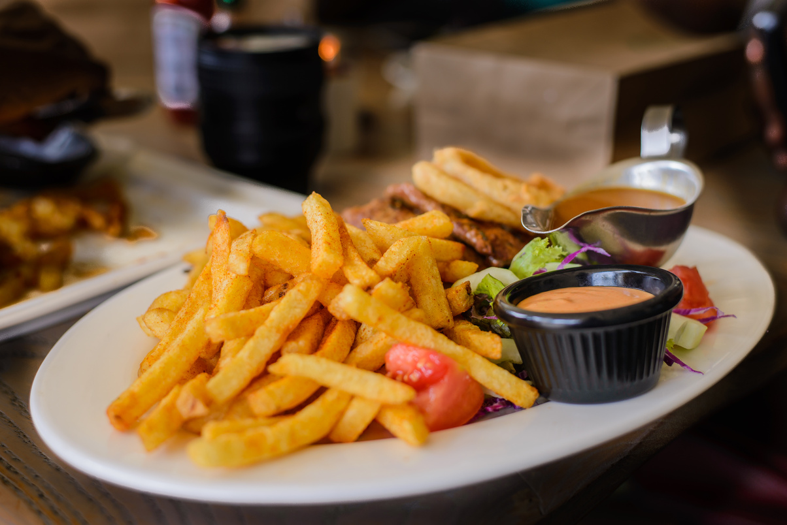
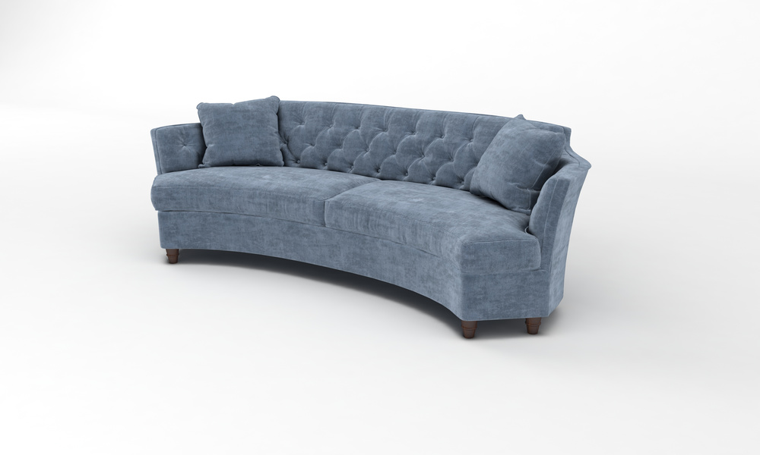
Datasets Used
Total 388 Classes
COCO2-27
(80 Random Obj Classes)
ImageNet-R
(200 Graphics Classes)
Food-101
(101 Food Classes)
Hugging Face Furniture-Dataset (7 Classes)

Slide 4
Models Information Phase 1 & 2: From-Scratch CNN on COCO-2017 (80-way, multi-label)
Architecture
A Keras Sequential CNN built from scratch, consisting of several Conv2D+MaxPooling2D blocks, followed by Flatten and a final Dense(80, activation='sigmoid') output layer.
Results
Training loss fell from ~0.15 to ~0.006
Val binary_accuracy peaked around 95.4% (last epoch: 0.9543) with val loss ~0.6943
Test set eval: loss = 0.6515, accuracy = 95.59%
Training Setup
Loss: binary crossentropy
Metric: binary_accuracy
Optimizer: (default Adam)
Epochs: 20
Batch size: 32 (default)
Image size: IMG_SIZE (e.g. 128×128)
Task & Data
Multi-label classification on COCO-2017 (80 object categories), images loaded via fiftyone.zoo.

Slide 5
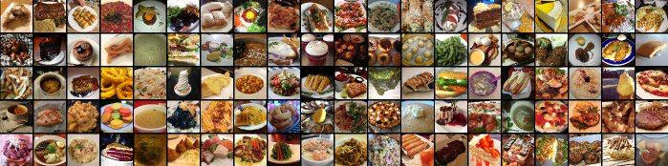
Phase 3: 181-way Fusion Model (COCO+Food101)
Task & Data
10-class classification on Food-101 (101-way), loaded via tfds.
Architecture
Loaded two pretrained “heads”:
Phase 2 CNN → 80-d output
Phase 3 CNN (own 101-way model) → 101-d output
Single Input(shape=(None,None,3)), two resize branches (256×256 → CNN₀, 128×128 → CNN₁), then Concatenate() → 181-d fused output with softmax.
Training Setup
Loss: categorical crossentropy
Metric: accuracy
Optimizer: Adam (default)
Epochs: 10
Batch size: 32
Results
Final: Train acc = 63.24%, Val acc = 48.21%, Train loss = 1.3849, Val loss = 2.3164

Slide 6
Phase 4: Fine-tuning MobileNetV2 on ImageNet-R
Task & Data
Classification on an ImageNet-R subset (2000 images → later 8000 images), loaded via torchvision.datasets.ImageFolder and random 80/20 split.
Results
First 10 epochs (2 K imgs)
Train acc rose from 2.9% → 73.5%
Val acc from 5.8% → 12.0% (peak 13.75% at epoch 6)
Final train loss ~1.16, val loss ~4.91
Extended 25 epochs (8 K imgs)
Best Val acc: 25.31% at epoch 6
Final: Train acc = 57.50%, Val acc = 20.25%, Train loss = 1.6452, Val loss = 4.8186
Architecture
Pretrained mobilenet_v2 from torchvision.models, with its final classifier head replaced to match your number of classes.
Training Setup
Loss: cross‐entropy
Optimizer: torch.optim (LR = 1 × 10⁻³)
Epochs:
Run 1: 10 epochs on 2 K images
Run 2: 25 epochs on 8 K images
Batch size: 32
Transforms: Resize 128×128, RandomHorizontalFlip, RandomRotation(15°), Normalize(mean=[0.485,0.456,0.406], std=[0.229,0.224,0.225])

Slide 7
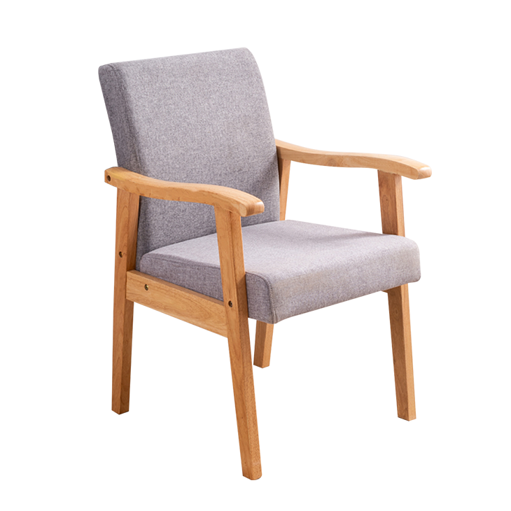
Phase 5: Fine-tuning ResNet-18 on Furniture Dataset
Task & Data
Multi-class furniture classification via ImageFolder on your custom dataset, 80/20 train/val split. Class mapping loaded from class_to_idx.json.
Architecture
Pretrained resnet18 from torchvision.models, with the final fc layer replaced to output N furniture classes.
Training Setup
Loss: cross‐entropy
Optimizer: Adam (LR = 3 × 10⁻⁵)
Epochs: 20
Batch size: 32
Img size: 128×128 plus typical torchvision transforms and normalization
Result
Peak Val acc ~86.1% around epochs 9–13; final train loss ~0.016

Slide 8

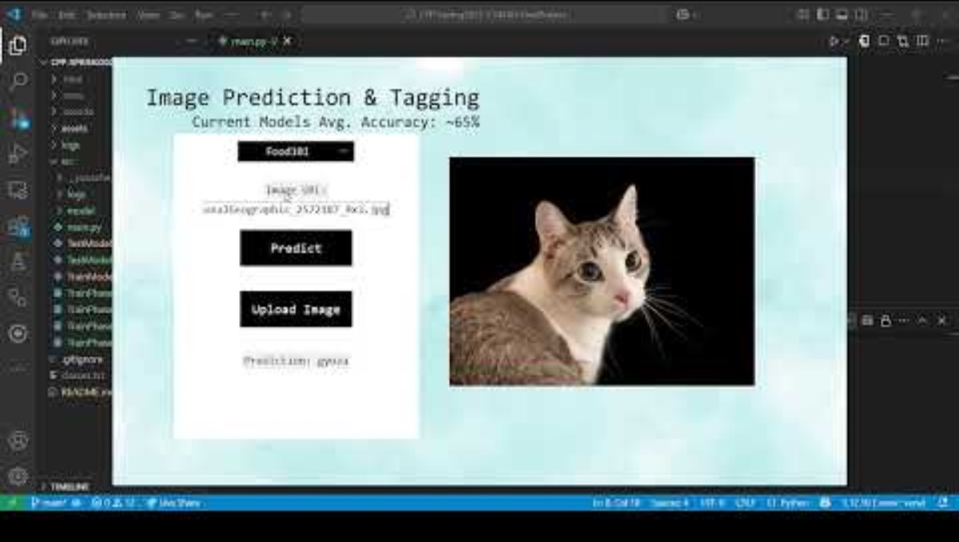
Demo Video: https://youtu.be/QIf7X2DXDBE?si=PsmQ7Naf-usmbMeg

Slide 9



Thank You
GitHub:
https://github.com/phyulwin
Project Repository:
https://github.com/phyulwin/ML-Image-Prediction-Tagging

